Slide 1
Popular Programming Tech
Part 8
Goroutines and Channels

Slide 2
Learning Objective
LO 1 : Explain fundamental concept of GO Programming Language
LO 2 : Apply GO programming language techniques and libraries

Slide 3
Outline
Goroutines
Concurrent clock server
Channels
Looping in paralle
Concurrent web crawler
Multiplexing with select
Cancellation

Slide 4
Goroutines and Channels
Go enables two styles of concur rent programming. This chapter presents goroutines and channels, which support communicating sequential processes or CSP, a model of concurrency in which values are passed between independent activities (goroutines) but variables are for the most par t confined to a single activity

Slide 5
Goroutines
Consider a program that has two functions, one that does some computation and one that writes some output, and assume that neither function calls the other
A sequential program may call one function and then call the other, but in a concur rent program with two or more goroutines, calls to both functions can be active at the same time
When a program starts, its only goroutine is the one that calls the main function, so we call it the main goroutine

Slide 6
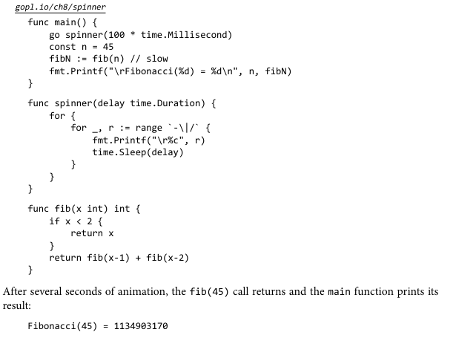

Slide 7
The main goroutine computes the 45th Fibonacci number
Since it uses the terribly inefficient recursive algorithm, it runs for an appreciable time, during which we’ d like to provide the user wit h a visual indication that the program is still running, by displaying an animated textual ‘‘spinner. ’
The main function then returns. When this happens, all goroutines are abruptly terminated and the program exits
Other than by returning from main or exiting the program, there is no programmatic way for one goroutine to stop another, but as we will see later, there are ways to communicate with a goroutine to request that it stop itself.

Slide 8
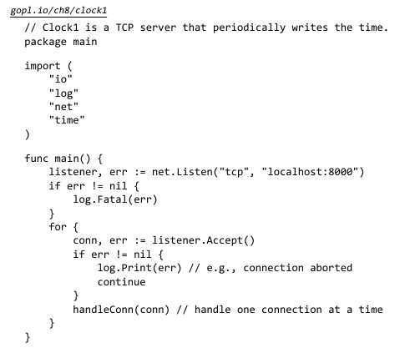
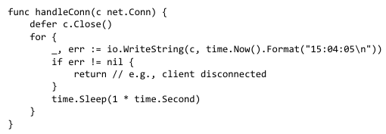
Example: Concurrent Clock Server

Slide 9
The Listen function creates a net.Listener, an object that listens for incoming connections on a network port, in this case TCP port localhost:8000.
The listener’s Accept method blocks until an incoming connection request is made, then returns a net.Conn object representing the connection

Slide 10

Channels
If goroutines are the activities of a concurrent Go program, channels are the connections between them
A channel is a communication mechanism that lets one goroutine send values to another goroutine
Each channel is a conduit for values of a particular type, called the channel’s element type
When we copy a channel or pass one as an argument to a function, we are copying a reference, so caller and callee refer to the same data structure

Slide 11

A channel has two principal operations, send and receive, collectively known as communications
A send statement transmits a value from one goroutine, through the channel, to another goroutine executing a corresponding receive expression
Channels support a third operation, close, which sets a flag indicating that no more values will ever be sent on this channel; subsequent attempts to send will panic

Slide 12
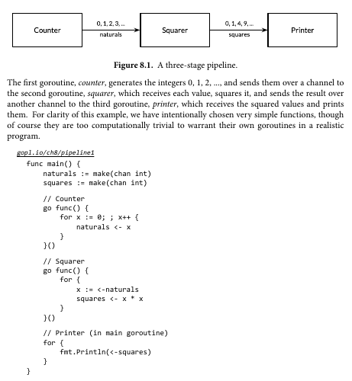

Slide 13
Looping in Parallel
gopl.io/ch8/thumbnail
package thumbnail
// ImageFile reads an image from infile and writes
// a thumbnail-size version of it in the same directory.
// It returns the generated file name, e.g., "foo.thumb.jpg".
func ImageFile(infile string) (string, error)
// makeThumbnails makes thumbnails of the specified files.
func makeThumbnails(filenames []string) {
for _, f := range filenames {
if _, err := thumbnail.ImageFile(f); err != nil {
log.Println(err)
}
}
}

Slide 14
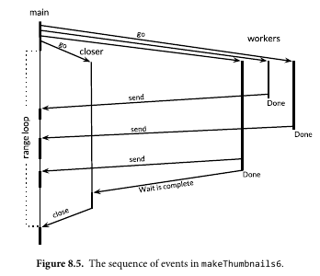

Slide 15
Chat server (Example)
There are four kinds of goroutine in this program. There is one instance apiece of the main and broadcaster goroutines, and for each client connection there is one handle-Conn and one clientWriter goroutine

Slide 16
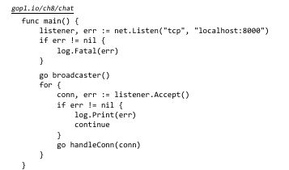
Main Class

Slide 17
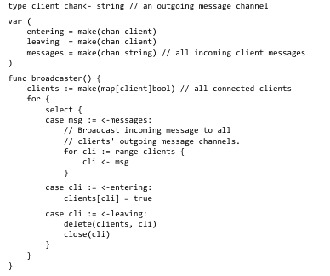
Broadcaster Class
The broadcaster listens on the global entering and leaving channels for announcements of
arriving and departing clients

Slide 18
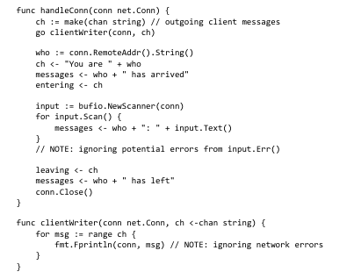
HandleConn class

Slide 19

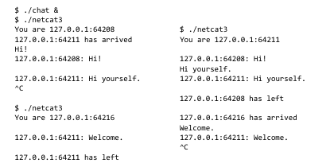
Result

Slide 20
References
https://www.golangprograms.com/goroutines.html
https://www.golangprograms.com/go-language/channels.html

